Slide 1
Reddit Hot Topics
Team : Kool Aid James Rinella, Brandon A,
Manvitha Vaduguru, Liaquat Ali

Slide 2
Overview
Project description
UI webpage
Sorting the csv file
JavaScripting for downloading image
Dynamic loading of images to webpage

Slide 3
Project Description
The goal is to process the Reddit threads dataset to understand the hot topic people are talking about.
After extracting top 10 news out of your dataset, use Google Api to search through the google and find the most related pictures to the extracted news.
You should also consider the time in which the topic is related about to find the pictures related to that topic on special time saved on the dataset
For detecting hot topics in the Reddit dataset, you may go for topic detection approach or clustering approach

Slide 4
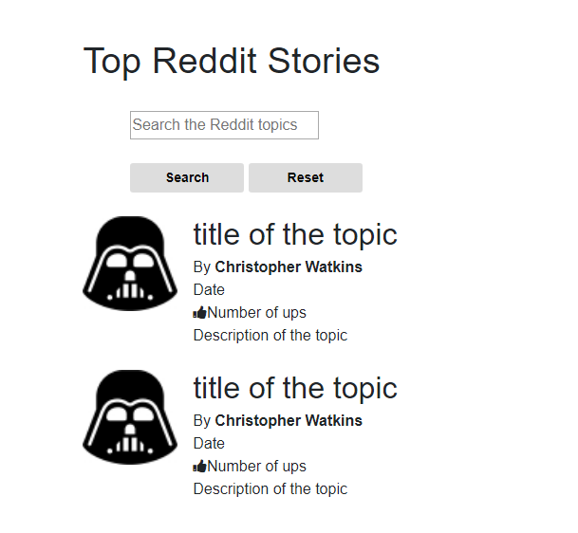
Webpage UI
I used the bootstrap and style.css for styling the webpage

